Slide 1
Overview of the ESGF Compute Working Team (CWT) and Target Milestones ESGF & UV-CDAT Face-to-Face December 2015
Daniel Duffy daniel.q.duffy@nasa.gov and on Twitter @dqduffy
High Performance Computing Lead at the
NASA Center for Climate Simulation (NCCS) – http://www.nccs.nasa.gov and @NASA_NCCS
Goddard Space Flight Center (GSFC) – http://www.nasa.gov/centers/goddard/home/

Slide 2
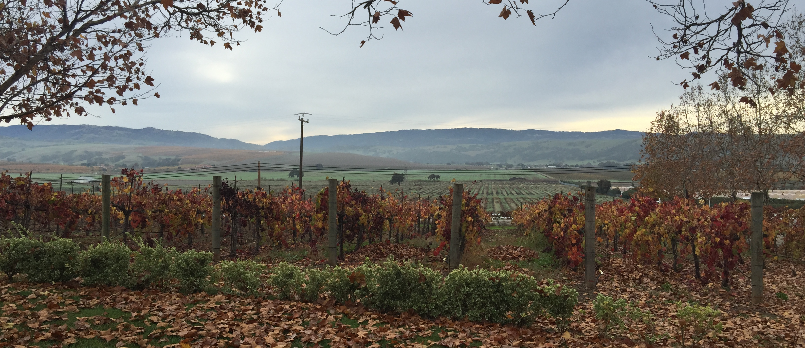
2014 ESGF Conference Venue

Slide 3
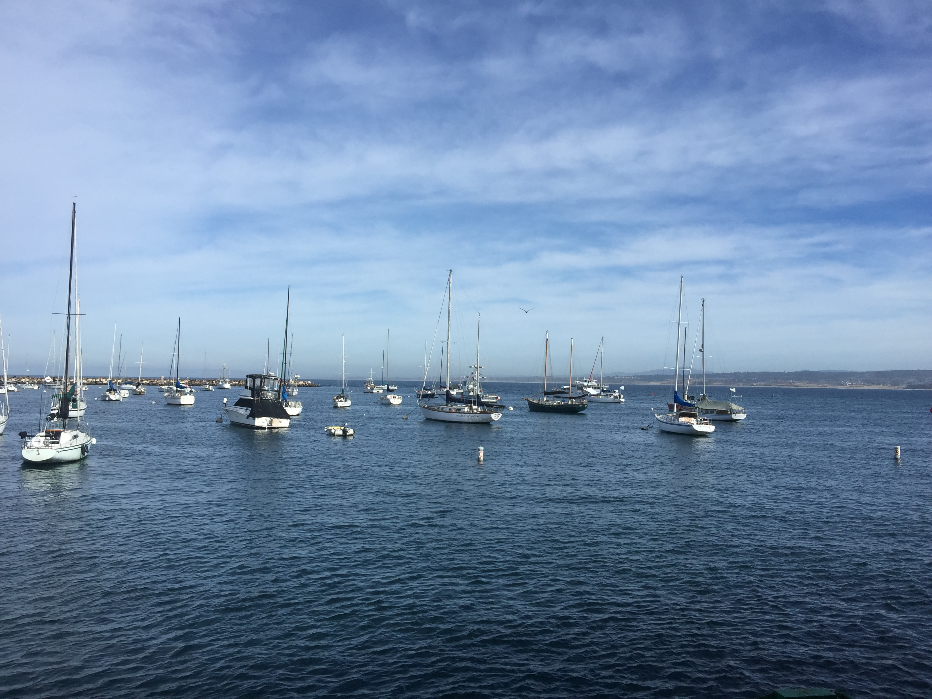
2015 ESFG Conference Venue

Slide 4
Compute Working Team (CWT)
Charge of the ESGF-CWT
Develop a general API for exposing ESGF distributed compute resources (HPC, clusters, clouds, etc.) to multiple analysis tools
Co-developing a reference architecture for the server-side processing capabilities
Use this reference architecture to test out the API and representative use cases
Process
Started out with use cases (simple operations, such as average, anomalies)
Worked through the use case to frame our thoughts and requirements
Compared and contrasted different viable APIs to settle in on developing a Web Processing Service (WPS)
Created an initial WPS specification document
Currently stored on confluence (still needs some cleaning up)
Initial reference implementation (Charles will present this)

Slide 5
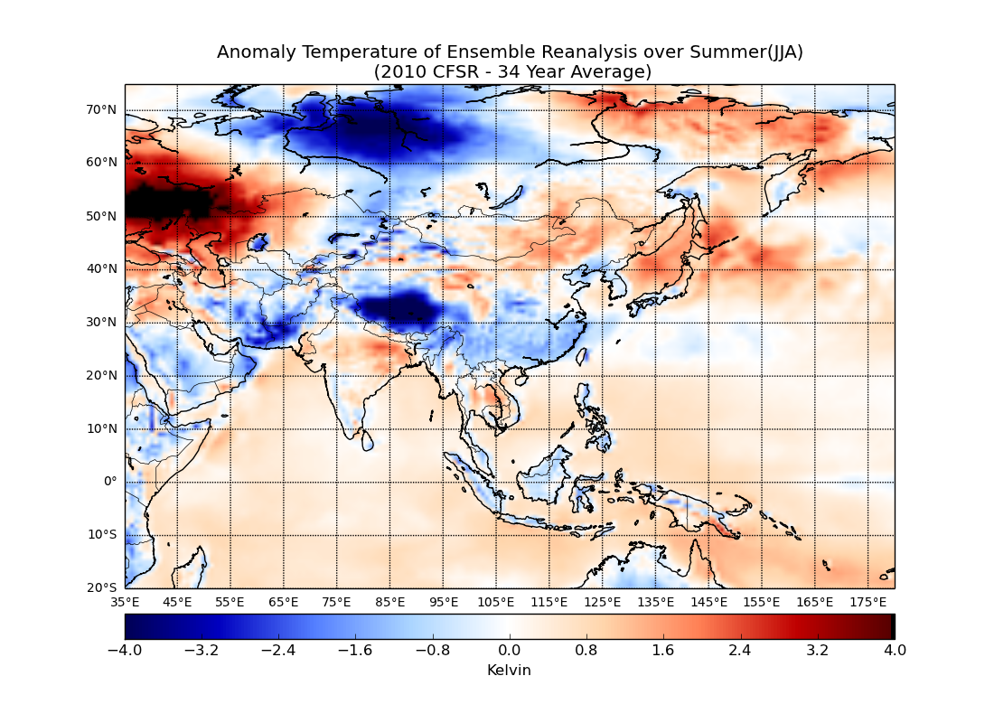
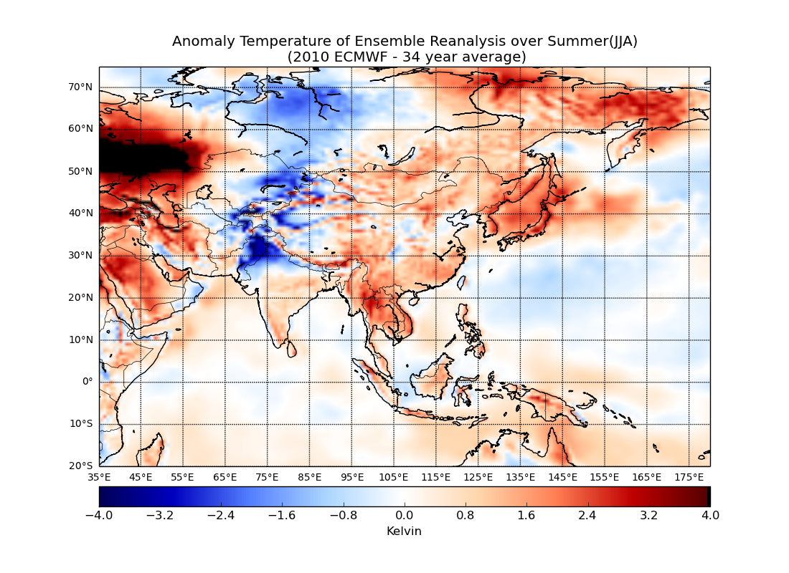
Representative Problem – Temperature Anomaly
Temperature anomalies between 34-year summer average and summer 2010 using the CFSR (left) and ECMWF (right) reanalyses. The long-term baseline ensemble average includes CFSR, ECMWF, and MERRA.
AGU IN31A-1750: Extending Climate Analytics-as-a-Service to the Earth System Grid Federation
Glenn S. Tamkin, John L. Schnase, Daniel Q. Duffy, Mark A. McInerney, Jian Li, Denis Nadeau, John H. Thompson, Savannah L. Strong
2015 ESGF Face-to-Face
5

Slide 6
Steps in Calculating the Anomaly
Calculate the average temperature from all collections to generate a long-term temporal span (34-years) across the surface of the Earth for summer (JJA).
Calculate the average temperature from the same collections for the summer of a single year (2010 for the example case).
Re-grid all results to the same spatial grid.
Calculate the ensemble average across the re-gridded results.
Calculate the anomaly (re-gridded average – re-gridded single year) for each of the ensemble members.
As you can see, this can get quite complicated even for a single, relatively simple and relevant, function.

Slide 7
Targeted Milestones
Timeline of Milestones for ESGF-CWT
February – March 2015
Finalize WPS API definition for the prototype use case (anomaly) and simple canonical operations
April – June 2015
Definition of a standard set of climate data to be initially exposed Definition of unit tests, data, input, and output to be used to verify the implementation of the WPS API At least one proof-of-concept implementation of the WPS API at a single site (not distributed at this point) First implementation of API and analysis for simple multi-model averaging use case
July-December 2015
Testing of the proof-of-concept implementation of the WPS API using the unit tests and the climate data Second proof-of-concept implementation at a second site using a different mechanism to perform the server-side analytics Expand use cases and a prioritization of additional capabilities to be exposed by the API
January – June 2016
Focus on federated analytics to extend the API to act upon data at two locations Expansion of the capabilities within the API based on the priorities set within the science discussions
July – December 2016
Expand and elevate the proof-of-concept to prototype at least at the two initial locations Continued expansion of the capabilities exposed within the API

Slide 8
Major Accomplishments
Initial specification document has been created and can be found on confluence
Compute Working Team (esgf-cwt) / API Standards and Requirements
Needs to be updated (will be working on that this week)
Reference implementation has been created
Charles will discuss this and demonstrate this in the next presentation.
Reference back end(s) have been discussed with some implementations
Tom Maxwell will discuss one reference implementation during this session.

Slide 9
Two Reference Back End Implementations
Client Side
WPS Client
Server Side/ ESGF Node
GetCapabilities – returns service-level metadata
DescribeProcess – returns a description of a process including its inputs and outputs
Execute –
returns the output(s) of a process
Web Processing Service
High-Performance Compute/Storage
Climate Data Analysis Service (CDAS)
AGU IN31A-1749: A WPS Based Architecture for Climate Data Analytic Services (CDAS) at NASA
Climate Analytics-as-a-Service (CAaaS)
AGU IN31A-1750: Extending Climate Analytics-as-a-Service to the Earth System Grid Federation
Traditional High-Performance Compute Cluster (shared everything)
Integrated Compute and Storage Cluster
(shared nothing)
MPI, scripts, Python, etc.
MapReduce, SQL, R, etc.
Tools such as UV-CDAT, numpy, ESMF, etc.
Hadoop, HIVE, Impala, Spark
Shared storage, such as GPFS or Lustre
Object storage, such as Hadoop
2015 ESGF Face-to-Face
9

Slide 10
Can we enable both with the same data?
Climate Data Analysis Service (CDAS)
AGU IN31A-1749: A WPS Based Architecture for Climate Data Analytic Services (CDAS) at NASA
Climate Analytics-as-a-Service (CAaaS)
AGU IN31A-1750: Extending Climate Analytics-as-a-Service to the Earth System Grid Federation
MPI, Open, Read, Write, etc.
MapReduce, Spark, ML
Traditional HPC
Big Data Analytics
This the problem.
Hadoop does not understand structured binary data.
Have to sequence the data; make another copy.
Network, IB, RDMA
Classical Usage Patterns
Data is moved to the process
Hadoop-Like Usage
Analytics moved to the data
Cloudera, Horton, BDAS
GPFS
POSIX Interface
RESTful Interface
Hadoop Connector
IBM Spectrum Scale (GPFS)
Object Store/Posix Parallel File System
Very large, scaling both horizontally (throughput) and vertically (capacity); permeated with compute capability at all levels
IBM Spectrum Scale (GPFS)
Server & JBOD
Commodity-Based Hardware
Traditional HPC Storage
2015 ESGF Face-to-Face
10

Slide 11
Not without something to enable native NetCDF with HDFS
Climate Data Analysis Service (CDAS)
AGU IN31A-1749: A WPS Based Architecture for Climate Data Analytic Services (CDAS) at NASA
Climate Analytics-as-a-Service (CAaaS)
AGU IN31A-1750: Extending Climate Analytics-as-a-Service to the Earth System Grid Federation
MPI, Open, Read, Write, etc.
MapReduce, Spark, ML
Traditional HPC
Big Data Analytics
Network, IB, RDMA
Classical Usage Patterns
Data is moved to the process
Hadoop-Like Usage
Analytics moved to the data
Cloudera, Horton, BDAS
SIA
GPFS
POSIX Interface
RESTful Interface
Hadoop Connector
IBM Spectrum Scale (GPFS)
Object Store/Posix Parallel File System
Very large, scaling both horizontally (throughput) and vertically (capacity); permeated with compute capability at all levels
IBM Spectrum Scale (GPFS)
Server & JBOD
Commodity-Based Hardware
Traditional HPC Storage
2015 ESGF Face-to-Face
11

Slide 12
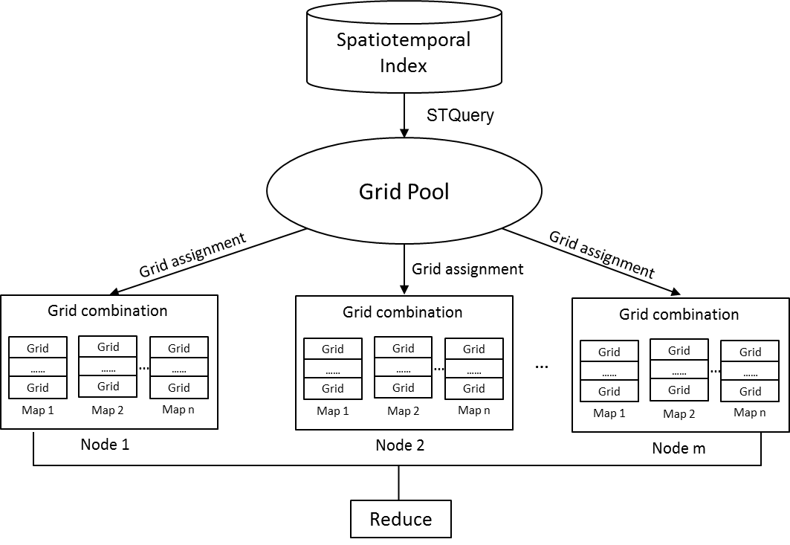
Spatiotemporal Index Approach (SIA) and HDFS
Build a spatiotemporal query model to connect the array-based data model with the key-value based MapReduce programming model using grid concept
Built a spatiotemporal index to
Use our knowledge of the structured scientific data to build an index
Link the logical to physical location of the data
Make use of an array-based data model within HDFS
Developed a grid partition strategy to
Keep high data locality for each map task
Balance the workload across cluster nodes
NCCS working with George Mason University (GMU); Presentation at AGU IN43B-1735: A Columnar Storage Strategy with Spatiotemporal Index for Big Climate Data
12
Notes:
Investigated a spatiotemporal query model to connect the array-based data model with the key-value based MapReduce programming model using grid concept

Slide 13
Steps for the Next Year
Update the specification documentation (hopefully a short term item)
Continue to expand the specification with representative use cases using
Standard set of climate data
Unit tests with data, input, and output for verification of the service implementation
Expansion of the specification to include additional use cases
The CWT will generate a prioritized list of capabilities to expose and start working on those
Instantiate multiple WPS instances across ESGF
Target to get at least two and potentially more sites to set up a WPS
NASA Goddard is planning on being a second site
Comparison of multiple back-end implementations
Much tighter integration with ESGF
Exploration of federated analysis and resource management

Slide 14
The 5 V’s of Data … and More
Let’s start with the 5 V’s of data that everyone knows…
Volume, Velocity, Veracity, Variety, Value
Others are adding more V’s …
Visualization, Variability, Viability
We came up with a few more at last night’s award ceremony that we thought this group should keep in mind as we move ESGF forward …
Lifecycle of Data
Viva La Data
Vintage
Vindictive
Vicious
Data Security
Vandalized
Victimized
Velociraptor
Voldemort
Just for fun
Vortex
Vice
Venomous
Vivacious

Slide 15
Team Members
The Earth System Grid Federation Compute Working Team is an international group consisting of members from ESGF data grid sites.
Co-Chairs
Charles Doutriaux (DOE/LLNL) doutriaux1@llnl.gov
Daniel Duffy (NASA/GSFC) daniel.q.duffy@nasa.gov
Members
Aashish Chaudhary, Ag Stephens, Alex Letzer, Aparna Radhakrishnan, Brian Smith, Carsten Ehbrecht, Dean Williams, Glenn Tamkin, Jeff Painter, Jim McEnergy, Luca C Cinquini, Maarten Plieger, Prashanth Chengi, Roland Schweitzer, Sergey Nikonov, Stephan Kindermann, Stephane Senesi, Tom Maxwell, V. Balaji, Giovanni Aloisio, Sandro Flore, Patrick Brokmann, Mark McInerney, Georgi Kostov, Antonio Cofino, Sasha Ames, Jean-Yves Peterschmitt, Ben Evans

